Slide 1
Overview of OS
1.1. Abstract view of an operating system
1.2 Fundamental principles of OS operations
1.3 OS interaction with the computer and user programs
1.4 Efficiency ,system performance and user service
1.5 Batch Processing System
1.6 Multiprogramming System
1.7 The Time Sharing System
1.8 The Real Time Operating System
1.9 Distributed operating system
1.10 Operation of OS
1.11 Operating system with monolithic structure
1.12 Virtual machine operating system
1.13 Microkernel based operating system

Slide 2
What is an Operating System?
Computer System = Hardware + Software
Software = Application Software + System Software(OS)
An Operating System is a system Software that acts as an intermediary/interface between a user of a computer and the computer hardware.
Operating system goals:
Execute user programs
Make solving user problems easier
Make the computer system convenient to use
Efficient use of computer hardware

Slide 3
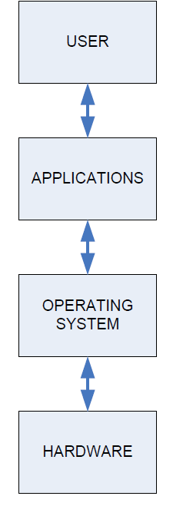
The Structure of Computer Systems
Accessing computer resources is divided into layers.
Each layer is isolated and only interacts directly with the layer below or above it.
If we install a new hardware device
No need to change anything about the user/applications.
However, you do need to make changes to the operating system.
You need to install the device drivers that the operating system will use to control the new device.
If we install a new software application
No need to make any changes to your hardware.
But we need to make sure the application is supported by the operating system
user will need to learn how to use the new application.
If we change the operating system
Need to make sure that both applications and hardware will compatible with the new operating system.

Slide 4
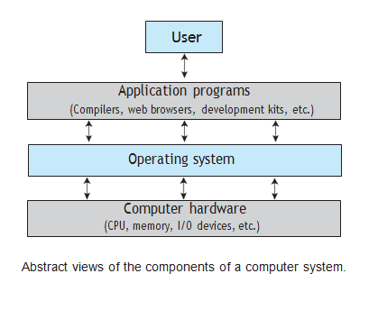

Slide 5
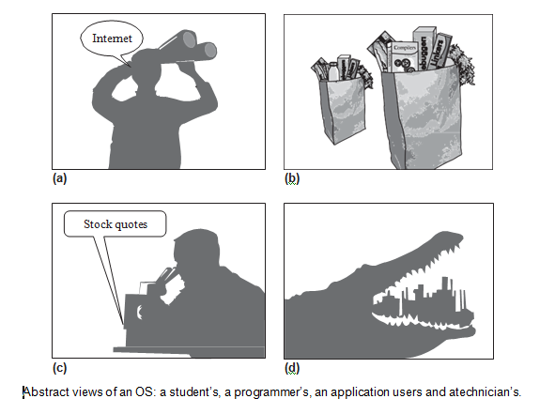

Slide 6
Abstract view of an operating system
Views of Operating System
An operating system is a framework that enables user application programs to interact with system hardware.
The operating system does not perform any functions on its own
It provides an atmosphere in which various apps and programs can do useful work.
The operating system may be observed from the point of view of the user or the system, and it is known as the user view and the system view.
There are mainly two types of views of the operating system. These are as follows:
User View
System View

Slide 7
User View
The user view depends on the system interface that is used by the users.
Some systems are designed for a single user to monopolize the resources to maximize the user's task.
In these cases, the OS is designed primarily for ease of use, with little emphasis on quality and none on resource utilization.
The user viewpoint focuses on how the user interacts with the operating system through the usage of various application programs.

Slide 8
System View
The system viewpoint focuses on how the hardware interacts with the operating system to complete various tasks.
The OS may also be viewed as just a resource allocator.
A computer system comprises various sources, such as hardware and software, which must be managed effectively.
The operating system manages the resources, decides between competing demands, controls the program execution, etc. According to this point of view, the operating system's purpose is to maximize performance.
The operating system is responsible for managing hardware resources and allocating them to programs and users to ensure maximum performance.

Slide 9
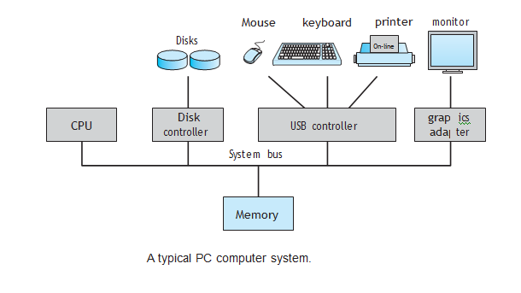

Slide 10
CPU – Central Processing Unit
This is the brain of your computer.
It performs all of the calculations.
In order to do its job, the CPU needs commands to perform, and data to work with.
The instructions and data travel to and from the CPU on the system bus.
The operating system provides rules for how that information gets back and forth, and how it will be used by the CPU.

Slide 11
RAM – Random Access Memory
This is like a desk, or a workspace, where your computer temporarily stores all of the information (data) and instructions (software or program code) that it is currently using.
Each RAM chip contains millions of address spaces.
Each address space is the same size, and has its own unique identifying number (address).
The operating system provides the rules for using these memory spaces, and controls storage and retrieval of information from RAM.
Device drivers for RAM chips are included with the operating system.

Slide 12
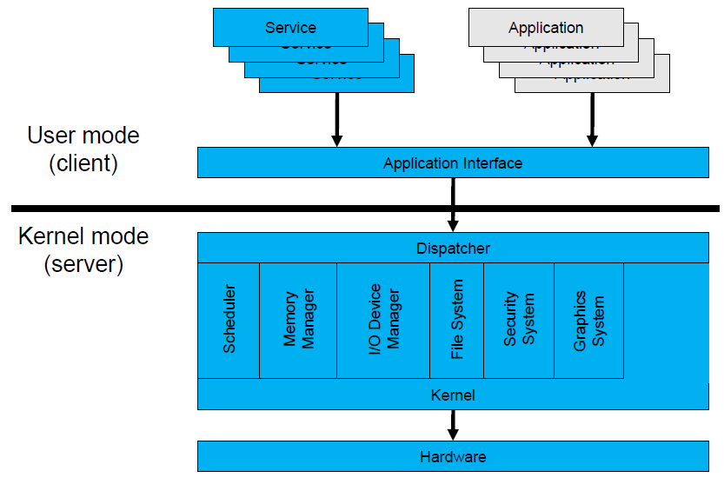
Operating System Mode
The User Mode is concerned with the actual interface between the user and the system.
It controls things like running applications and accessing files.
The Kernel Mode is concerned with everything running in the background.
It controls things like accessing system resources, controlling hardware functions and processing program instructions.
System calls are used to change mode from User to Kernel.

Slide 13
Kernel
It reside in central core of OS.
It has complete control over system.
When operation system boots, kernel is first part of OS to load in main memory.
Kernel remains in main memory for entire duration of computer session.
The kernel code is usually loaded in to protected area of memory.
Kernel performs it’s task like executing processes and handling interrupts in kernel space.
User performs it’s task in user area of memory.
This memory separation is made in order to prevent user data and kernel data from interfering with each other.
Kernel does not interact directly with user, but it interacts using SHELL and other programs and hardware.

Slide 14
Kernel cont…
Kernel includes:-
1. Scheduler: It allocates the Kernel’s processing time to various processes.
2. Supervisor: It grants permission to use computer system resources to each process.
3. Interrupt handler : It handles all requests from the various hardware devices which compete for kernel services.
4. Memory manager : allocates space in memory for all users of kernel service.
kernel provides services for process management, file management, I/O management, memory management.
System calls are used to provide these type of services.

Slide 15
System Call
System call is the programmatic way in which a computer program/user application requests a service from the kernel of the operating system on which it is executed.
Application program is just a user-process. Due to security reasons , user applications are not given access to privileged resources(the ones controlled by OS).
When they need to do any I/O or have some more memory or spawn a process or wait for signal/interrupt, it requests operating system to facilitate all these. This request is made through System Call.
System calls are also called software-interrupts.

Slide 16
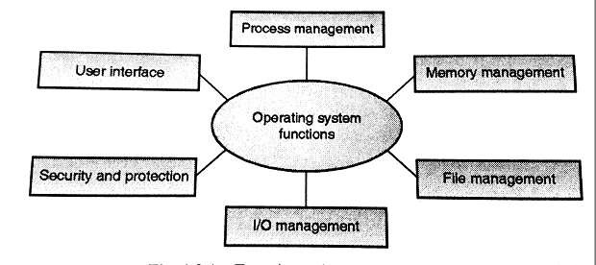
Functions of Operating System

Slide 17
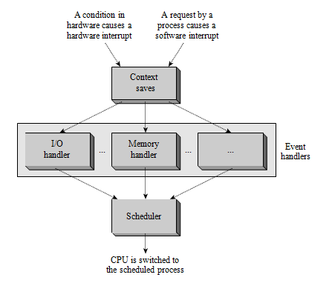

Slide 18
1. Process Management
A process is a program in execution.
A process needs certain resources, including CPU time, memory, files, and I/O devices to accomplish its task.
Simultaneous execution leads to multiple processes.
Creation, execution and termination of a process are the most basic functionality of an OS
Dependent Processes :- than they may try to share same resources. thus task of process synchronization comes to the picture.
Independent processes:- than a due care needs to be taken to avoid their overlapping in memory area.
Based on priority, it is important to allow more important processes to execute first than others.

Slide 19
2. Memory management
Memory is a large array of words or bytes, each with its own address.
It is a repository of quickly accessible data shared by the CPU and I/O devices.
Main memory is a volatile storage device. When the computer made turn off everything stored in RAM will be erased automatically.
In addition to the physical RAM installed in your computer, most modern operating systems allow your computer to use a virtual memory system. Virtual memory allows your computer to use part of a permanent storage device (such as a hard disk) as extra memory.
The operating system is responsible for the following activities in connections with memory management:
Keep track of which parts of memory are currently being used and by whom.
Decide which processes to load when memory space becomes available.
Allocate and de-allocate memory space as needed.

Slide 20
3. File Management
A file is a collection of related information defined by its creator.
File systems provide the conventions for the encoding, storage and management of data on a storage device such as a hard disk.
FAT12 (floppy disks)
FAT16 (DOS and older versions of Windows)
FAT32 (older versions of Windows)
NTFS (newer versions of Windows)
EXT3 (Unix/Linux)
HFS+ (Max OS X)
The operating system is responsible for the following activities in connections with file management:
✦ File creation and deletion.
✦ Directory creation and deletion.
✦ Support of primitives for manipulating files and directories.
✦ Mapping files onto secondary storage.
✦ File backup on stable (nonvolatile) storage media.

Slide 21
4. Device Management or I/O Management
Device controllers are components on the motherboard (or on expansion cards) that act as an interface between the CPU and the actual device.
Device drivers, which are the operating system software components that interact with the devices controllers.
A special device (inside CPU) called the Interrupt Controller handles the task of receiving interrupt requests and prioritizes them to be forwarded to the processor.
Deadlocks can occur when two (or more) processes have control of different I/O resources that are needed by the other processes, and they are unwilling to give up control of the device.
It performs the following activities for device management.
Keeps tracks of all devices connected to system.
Designates a program responsible for every device known as Input/output controller.
Decides which process gets access to a certain device and for how long.
Allocates devices in an effective and efficient way.
Deallocates devices when they are no longer required.

Slide 22
5. Security & Protection
The operating system uses password protection to protect user data and similar other techniques.
It also prevents unauthorized access to programs and user data by assigning access right permission to files and directories.
The owners of information stored in a multiuser or networked computer system may want to control use of that information, concurrent processes should not interfere with each other.

Slide 23
6. User Interface Mechanism
A user interface (UI) controls how you enter data and instructions and how information is displayed on the screen
There are two types of user interfaces
Command Line Interface
Graphical user Interface

Slide 24
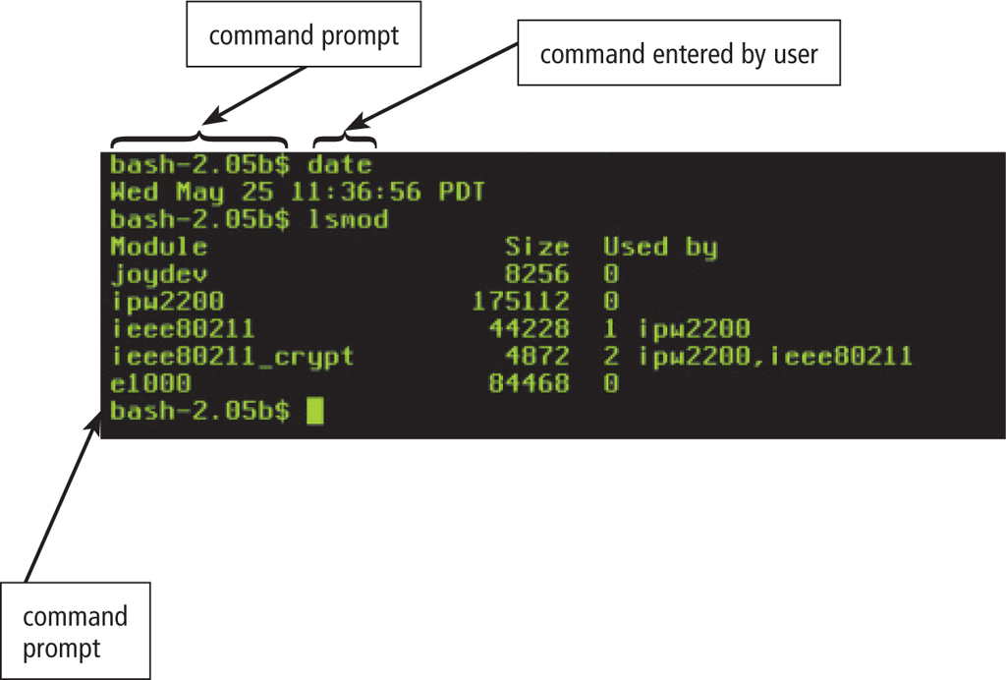
1. Command-line interface
In a command-line interface, a user types commands represented by short keywords or abbreviations or presses special keys on the keyboard to enter data and instructions

Slide 25
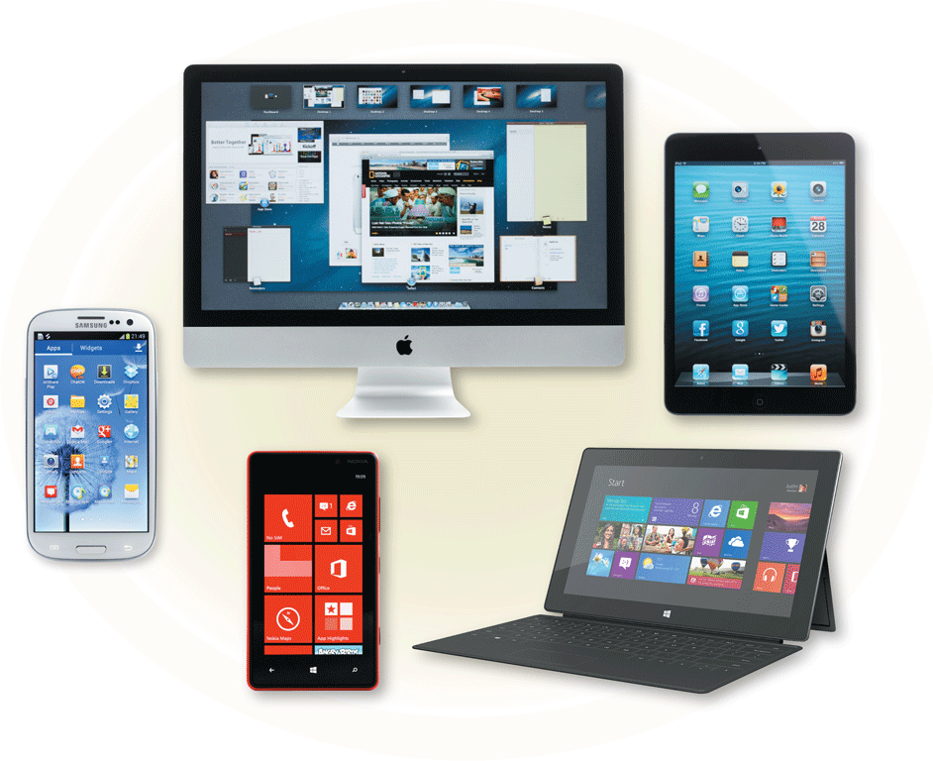
2. Graphical User Interface
With a graphical user interface (GUI), you interact with menus and visual images

Slide 26
Starting an Operating System(Booting)
Power On Switch sends electricity to the motherboard on a wire called the Voltage Good line.
If the power supply is good, then the BIOS (Basic Input/Output System) chip takes over.
In Real Mode, CPU is only capable of using approximately 1 MB of memory built into the motherboard.
The BIOS will do a Power-On Self Test (POST) to make sure that all hardware are working.
BIOS will then look for a small sector at the very beginning of your primary hard disk called MBR.
The MBR contains a list, or map, of all of the partitions on your computer‘s hard disk (or disks).
After the MBR is found the Bootstrap Loader follows basic instructions for starting up the rest of the computer, including the operating system.
In Early Kernel Initialization stage, a smaller core of the Kernel is activated.
This core includes the device drivers needed to use computer‘s RAM chips.

Slide 27
BIOS(Basic Input Output System)
BIOS firmware was stored in a ROM/EPROM (Erasable Programmable Read-Only Memory) chip known as firmware on the PC motherboard.
BIOS can be accessed during the initial phases of the boot procedure by pressing del, F2 or F10.
Finally, the firmware code cycles through all storage devices and looks for a boot-loader. (usually located in first sector of a disk which is 512 bytes)
If the boot-loader is found, then the firmware hands over control of the computer to it.

Slide 28
UEFI(Unified Extensible Firmware Interface)
UEFI stands for Unified Extensible Firmware Interface. It does the same job as a BIOS, but with one basic difference: it stores all data about initialization and start up in an .efi file, instead of storing it on the firmware.
This .efi file is stored on a special partition called EFI System Partition (ESP) on the hard disk. This ESP partition also contains the boot loader.
UEFI was designed to overcome many limitations of the old BIOS, including:
UEFI supports drive sizes up to 9 zetta bytes, whereas BIOS only supports 2.2 terabytes.
UEFI provides faster boot time.
UEFI has discrete driver support, while BIOS has drive support stored in its ROM, so updating BIOS firmware is a bit difficult.
UEFI offers security like "Secure Boot", which prevents the computer from booting from unauthorized/unsigned applications. This helps in preventing root kits.
UEFI runs in 32bit or 64bit mode, whereas BIOS runs in 16bit mode. So UEFI is able to provide a GUI (navigation with mouse) as opposed to BIOS which allows navigation only using the keyboard.

Slide 29
Fundamental principles of OS operations
An operating system is a software component of a computer, and is responsible for the management of a variety of computer operations as also the sharing of computer resources. It hosts computer applications and handles the operations of computer hardware. Users and application programs access the operating system services through system calls and application programming interfaces. In short, an operating system acts as an interface between the application programs and the computer hardware. Desktop computers, PDAs, laptop computers, notebook computers and even most mobile phones of today, come with an operating system.
Access Control
Execution of Programs
User Interface
Memory Management
Scheduling
Interrupt Handling
Management of Files
Computer Security
Computer Networking

Slide 30
Efficiency ,system performance and user service
Program execution
To execute a program, several tasks need to be performed. Both the instructions and data must be loaded into the main memory. In addition, input-output devices and files should be initialized, and other resources must be prepared. The Operating structures handle these kinds of tasks. The user now no longer should fear the reminiscence allocation or multitasking or anything.
Control Input/output devices
As there are numerous types of I/O devices within the computer system, and each I/O device calls for its own precise set of instructions for the operation. The Operating System hides that info with the aid of presenting a uniform interface. Thus, it is convenient for programmers to access such devices easily.

Slide 31
Program Creation
The Operating system offers the structures and tools, including editors and debuggers, to help the programmer create, modify, and debugging programs.
Error Detection and Response
An Error in a device may also cause malfunctioning of the entire device. These include hardware and software errors such as device failure, memory error, division by zero, attempts to access forbidden memory locations, etc. To avoid error, the operating system monitors the system for detecting errors and takes suitable action with at least impact on running applications

Slide 32
Accounting
An Operating device collects utilization records for numerous assets and tracks the overall performance parameters and responsive time to enhance overall performance. These personal records are beneficial for additional upgrades and tuning the device to enhance overall performance.
Security and Protection
Operating device affords safety to the statistics and packages of a person and protects any interference from unauthorized users. The safety feature counters threats, which are published via way of individuals out of doors the manage of the running device.

Slide 33
File management
Computers keep data and information on secondary storage devices like magnetic tape, magnetic disk, optical disk, etc. Each storage media has its capabilities like speed, capacity, data transfer rate, and data access methods.
For file management, the operating system must know the types of different files and the characteristics of different storage devices. It has to offer the proportion and safety mechanism of documents additionally.
Communication
The operating system manages the exchange of data and programs among different computers connected over a network. This communication is accomplished using message passing and shared memory.

Slide 34
1. Batch Operating System
The users of this type of operating system does not interact with the computer directly.
Each user prepares his job on an off-line device like punch cards and submits it to the computer operator
There is an operator which takes similar jobs having the same requirement and group them into batches.
Open-source operating system designed to manage multiple jobs in sequence
It Includes a command line interface,
Library for scheduling tasks, and a user interface for managing tasks.
Batch OS is designed to simplify the process of managing and scheduling tasks across a network of computers.

Slide 35
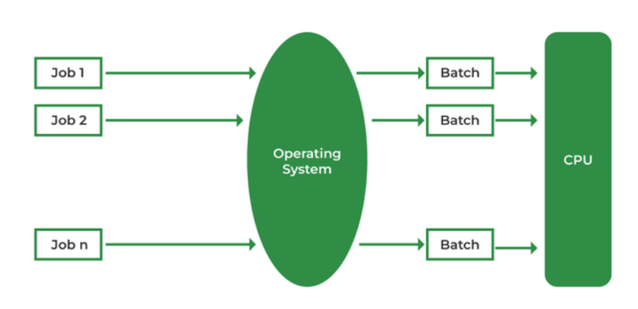
Batch Processing Operating System

Slide 36
Advantages of Batch Operating System:
Processors of the batch systems know how long the job would be when it is in queue
Multiple users can share the batch systems
The idle time for the batch system is very less
It is easy to manage large work repeatedly in batch systems
Disadvantages of Batch Operating System:
The computer operators should be well known with batch systems
Batch systems are hard to debug
It is sometimes costly
The other jobs will have to wait for an unknown time if any job fails
Examples of Batch based Operating System:
IBM's MVS

Slide 37
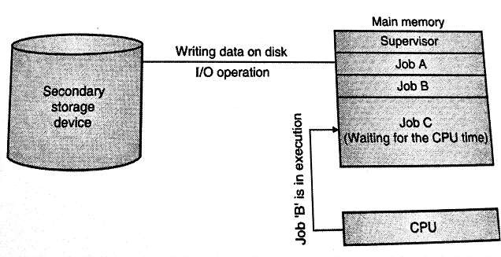
2. Multiprogramming Operating System:
This type of OS is used to execute more than one jobs simultaneously by a single processor.
It increases CPU utilization by organizing jobs so that the CPU always has one job to execute.
Multiprogramming operating systems use the mechanism of job scheduling and CPU scheduling.

Slide 38
Multiprogramming Operating System
A multiprogramming operating system may run many programs on a single processor computer. If one program must wait for an input/output transfer in a multiprogramming operating system, the other programs are ready to use the CPU.
Types of the Multiprogramming Operating System
Multitasking Operating System
A multitasking operating system enables the execution of two or more programs at the same time. The operating system accomplishes this by shifting each program into and out of memory one at a time. When a program is switched out of memory, it is temporarily saved on disk until it is required again.
2. Multiuser Operating System
A multiuser operating system allows many users to share processing time on a powerful central computer from different terminals. The operating system accomplishes this by rapidly switching between terminals, each of which receives a limited amount of processor time on the central computer. The operating system changes among terminals so quickly that each user seems to have continuous access to the central computer. If there are many users on a system like this, the time it takes the central computer to reply can become more obvious.

Slide 39
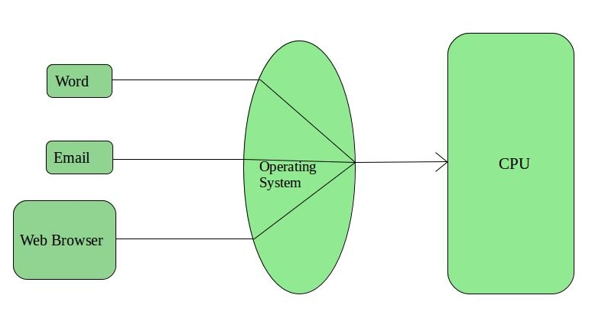
3. Time-Sharing Operating Systems
Each task is given some time to execute so that all the tasks work smoothly.
These systems are also known as Multi-tasking Systems.
The task can be from a single user or different users also.
The time that each task gets to execute is called quantum.
After this time interval is over OS switches over to the next task.

Slide 40
Advantages of Time-Sharing OS:
Each task gets an equal opportunity
Fewer chances of duplication of software
CPU idle time can be reduced
Disadvantages of Time-Sharing OS:
Reliability problem
One must have to take care of the security and integrity of user programs and data
Data communication problem
Examples of Time-Sharing Oss
Multics, Unix, etc.

Slide 41
Time-Sharing Operating Systems is one of the important type of operating system.
Time-sharing enables many people, located at various terminals, to use a particular computer system at the same time. Multitasking or Time-Sharing Systems is a logical extension of multiprogramming. Processor’s time is shared among multiple users simultaneously is termed as time-sharing.
Advantages of Timesharing operating systems are −
It provides the advantage of quick response.
This type of operating system avoids duplication of software.
It reduces CPU idle time.
Disadvantages of Time-sharing operating systems are −
Time sharing has problem of reliability.
Question of security and integrity of user programs and data can be raised.
Problem of data communication occurs.

Slide 42
4. Distributed Operating System
A system consisting of two or more nodes, where each node is a computer system with its own clock and memory, some networking hardware, and a capability of performing some of the control functions of an OS.
Various autonomous interconnected computers communicate with each other using a shared communication network.
Independent systems possess their own memory unit and CPU.
These are referred to as loosely coupled systems.
Examples:- Locus, DYSEAC

Slide 43
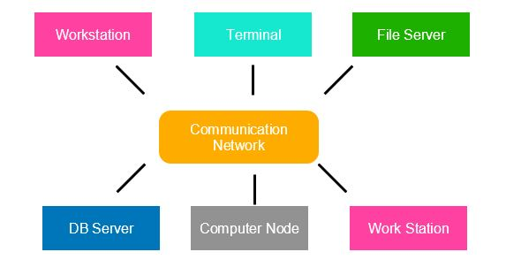

Slide 44
It handles all the interactions between the software and the hardware.
Several computer systems connected through a single communication channel.
These systems have their individual processors and memory.
Processors communicate through high-speed buses or telephone lines.
These individual systems that connect through a single channel are considered as a single unit. We can also call them loosely coupled systems.
The individual components or systems of the network are nodes.
Types of Distributed Operating System
1. Client/Server Systems
In this system, the client requests the server for a resource. On the other hand, the server provides this resource to the client. One client contacts only a single server at a time. Whereas a single server can deal with multiple clients simultaneously. The clients and servers connect through a computer network in the system.
2. Peer to Peer Systems
In this system, the nodes play an important role. All the work equally divides among the nodes. Furthermore, these nodes can share data or resources as per the requirement. Again, they require a network to connect.

Slide 45
Advantages
Give more performance than single system
If one pc in distributed system malfunction or corrupts then other node or pc will take care of
More resources can be added easily
Resources like printers can be shared on multiple pc’s
Disadvantages
Security problem due to sharing
Some messages can be lost in the network system
Bandwidth is another problem if there is large data then all network wires to be replaced which tends to become expensive
Overloading
If there is a database connected then performance become slow
The databases in network operating is difficult to administrate then single user system
Examples
Windows server 2003 Windows server 2008 Windows server 2012 Ubuntu Linux

Slide 46
Beneﬁts of Distributed Operating Systems
Resource sharing Resources can be utilized across boundaries of individual computer systems.
Reliability The OS continues to function even when computer systems or resources in it fail.
Computation speedup Processes of an application can be executed in different computer systems to speed up its completion.
Communication Users can communicate among themselves irrespective of their locations in the system.

Slide 47
5.Real-time operating system
It is is a special-purpose operating system
If it require to complete its work then necessary to deliver its service on time.
strict time constraints
Uses where results of the computations are used to influence a process while it is executing.
Sensor used to monitor the event.
The sensor produces the signal that is interpreted by the operating system as an interrupt.
On receiving an interrupt, the operating system invokes a specific process or a set of processes to serve the interrupt.
It is used to implement a computer application for controlling or tracking of real-world activities.
The application needs to complete its computational tasks in a timely manner to keep abreast of external events in the activity that it controls.

Slide 48
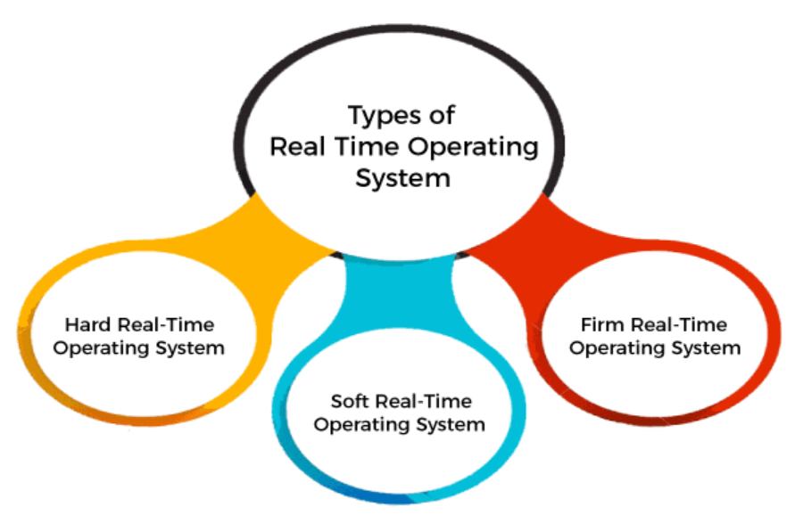

Slide 49
Hard Real-Time operating system:
In Hard RTOS, all critical tasks must be completed within the specified time duration, i.e., within the given deadline.
Not meeting the deadline would result in critical failures such as damage to equipment or even loss of human life.
airplane sensor and autopilot systems, spacecrafts and planetary rovers
Soft Real-Time operating system:
Soft RTOS accepts a few delays via the means of the Operating system. In this kind of RTOS, there may be a closing date assigned for a particular job,
but a delay for a small amount of time is acceptable. So, cut off dates are treated softly via means of this kind of RTOS.
Autopilot systems, aero plane sensors, spacecraft,
Firm Real-Time operating system:
In Firm RTOS additionally want to observe the deadlines. However, lacking a closing date might not have a massive effect,
however may want to purposely undesired effects, like a massive discount within the fine of a product.
financial forecast systems, robotic assembly lines

Slide 50
Real-Time Operating System
These types of OSs serve real-time systems.
The time interval required to process and respond to inputs is very small.
This time interval is called response time.
Real-time systems are used when there are time requirements that are very strict like
missile systems,
air traffic control systems,
robots, etc.

Slide 51
Features of a Real-Time Operating System
Concurrency within an application A programmer can indicate that some parts of an application should be executed concurrently with one another. The OS considers execution of each such part as a process.
Process priorities
A programmer can assign priorities to processes. Scheduling The OS uses priority-based or deadline-aware scheduling.
Domain-speciﬁc events, interrupts
A programmer can deﬁne special situations within the external system as events, associate interrupts with them, and specify event handling actions for them.
Predictability
Policies and overhead of the OS should be predictable.
Reliability
The OS ensures that an application can continue to function even when faults occur in the computer.

Slide 52
6 Virtual machine operating system
A virtual machine (VM) is a virtual environment which functions as a virtual computer system with its own CPU, memory, network interface, and storage, created on a physical hardware system.
VMs are isolated from the rest of the system, and multiple VMs can exist on a single piece of hardware, like a server.
That means, it as a simulated image of application software and operating system which is executed on a host computer or a server.
Characteristics of virtual machines
Multiple OS systems use the same hardware and partition resources between virtual computers.
Separate Security and configuration identity.
Ability to move the virtual computers between the physical host computers as holistically integrated files.

Slide 53
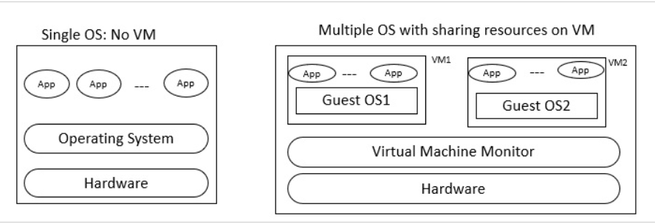

Slide 54
1. Security
Not all the applications available on the internet is genuine. Some of them could pose serious threats to the system. Virtual machines provide an option known as guest operating system which allows applications to run in guest mode. So whatever the damage that the application causes is only temporary.
2.Reliability
A virtual machine includes virtual resources as well. Everything is virtualized including the hard disk drive. Thus, even if the even if the machine crashes there will be no problem to the host computer.
3. ISA Structure
Instruction Set Architecture (ISA) is an abstract which differentiates hardware and software. Always the ISA provided by the virtual machine is different from that of a physical computer. Hence, the tasks that are to be executed by the hardware are separated primarily.
4. Multiple O/S
Every software on the virtual machines are virtually separated from the host computer. As a result, users will be able to run multiple operating system on a single computer all being isolated from each other. This overall leads to time management as well as cost savings for a company.
5. Malware identification
A separate sandbox environment is provided by a virtual machine to test applications. This helps to identify malware before it infects a computer. And also, since a virtual machine does not have any direct contacts with the host computer, the malware will not cause much damage.

Slide 55
Disadvantages of Virtual Machine
1. Cost
Running a virtual machine with a cloud computing service is generally considered to be expensive. The upfront costs involved in a virtual machine makes it costly. And depending on the need this cost varies. If there is more need more investments needs to be done.
2. Performance
Even though the machines are virtualized in a virtual machine, it still relies on the resources from the host machine. A computer needs to be powerful enough to run several virtual machines on a single host computer. If its power is not sufficient enough, it will cause stability issues in the performance.
3. Efficiency
In terms of hardware accessibility a virtual machine is less efficient. It cannot access the hardware directly. And also its speed is not sufficient for most IT firms. This makes them use a system that is balanced between virtual and physical.
4. Complexity
A virtual machine is a complex system. What makes it complex is the multiple local area networks it is equipped with. Therefore, in case of any failure it will be difficult to figure out where the fault has occurred. Especially for the people who are familiar with the structure and hardware of the virtual machine.
5. Infections
A weak host system can easily be affected by infections. This usually happens when there is bugs in the operating system. If two or more virtual machines are connected with each other, the infections would spread to others as well.

Slide 56
Operations of Operating System
Cache Management. Information is normally kept in some storage system (such as main memory).
As it is used, it is copied into a faster storage system— the cache— on a temporary basis
When we need a particular piece of information, we first check whether it is in the cache.
If it is, we use the information directly from the cache.
I/O System Management
A general device-driver interface
Drivers for specific hardware devices
Security and Protection
Virtualization

Slide 57
Mass-Storage Management
Mounting and unmounting
Free-space management
Storage allocation
Disk scheduling
Partitioning
Protection

Slide 58
Memory Management
Keeping track of which parts of memory are currently being used and which process is using them
Allocating and deallocating memory space as needed
Deciding which processes (or parts of processes) and data to move into and out of memory
File-System Management
Creating and deleting files
Creating and deleting directories to organize files
Supporting primitives for manipulating files and directories
Mapping files onto mass storage
Backing up files on stable (nonvolatile) storage media

Slide 59
Multiprogramming increases CPU utilization
Multitasking is a logical extension of multiprogramming, CPU executes multiple processes by switching among them, but the switches occur frequently, providing the user with a fast response time.
Modes of operation: user mode and kernel mode (also called supervisor mode, system mode, or privileged mode)
Resource Management As we have seen, an operating system is a resource manager. The system’s CPU, memory space, file-storage space, and I/O devices are among the resources that the operating system must manage
Creating and deleting both user and system processes
Scheduling processes and threads on the CPUs
Suspending and resuming processes
Providing mechanisms for process synchronization
Providing mechanisms for process communication

Slide 60
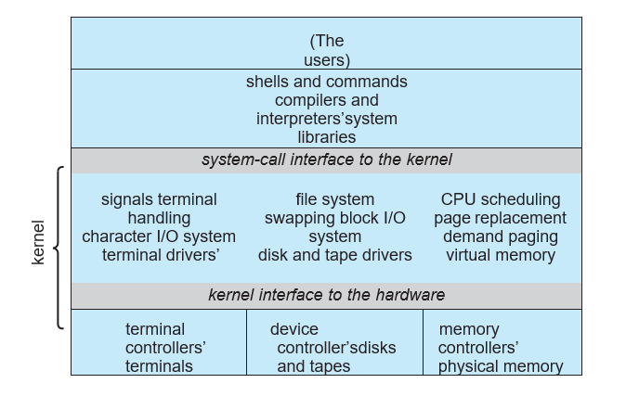
Operating system with Monolithic Strecture

Slide 61
The simplest structure for organizing
An operating system is no structure at all.
All of the functionality of the kernel into a single, static binary file that runs in a single address space.
Eg. original UNIX operating system.
Everything below the system-call interface and above the physical hardware is the kernel. The kernel provides the file system, CPU scheduling, memory management, and other operating- system functions through system calls. Taken in sum, that is an enormous amount of functionality to be combined into one single address space.
The Linux kernel is monolithic in that it runs entirely in kernel mode in a single address space.
The monolithic approach is often known as a tightly coupled system because changes to one part of the system can have wide-ranging effects on other parts.

Slide 62
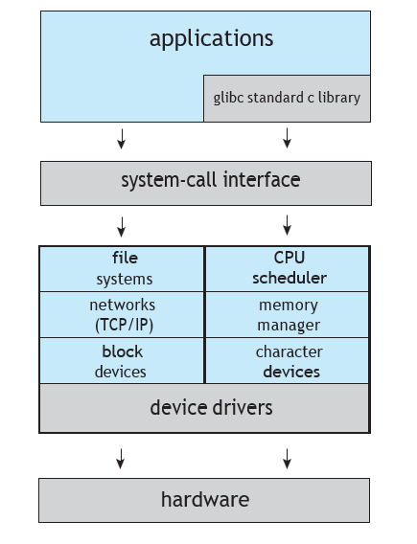

Slide 63
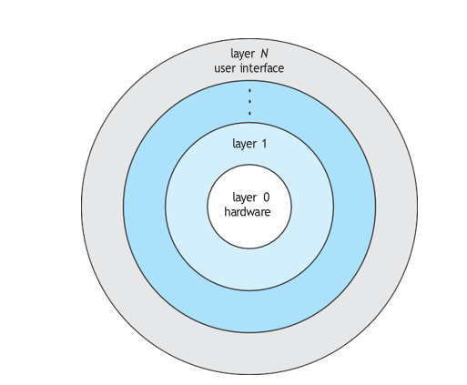

Slide 64
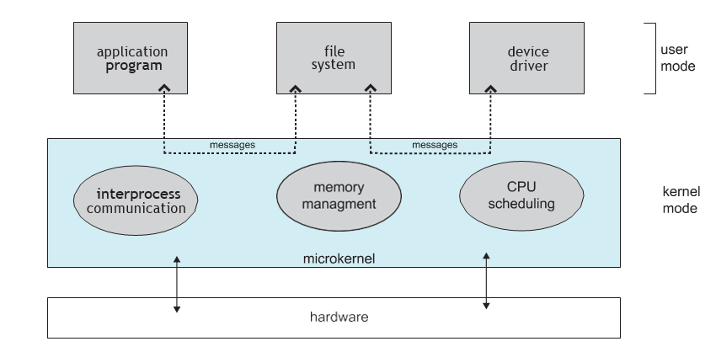
Microkernel Based Operating System

Slide 65
As UNIX expanded, the kernel became large and difficult to manage.
In the mid-1980s, researchers at Carnegie Mellon University developed an operating system called Mach that modularized the kernel using the micro- kernel approach.
This method structures the operating system by removing all non essential components from the kernel and implementing them as user- level programs that reside in separate address spaces
Advantages :-
Flexibility
Extensibility
Safety
Hardware Independent
Correctness
Modularity
Disadvantages/ Issues :-
Slow
Interposes Communication
Virtual Memory Management

Slide 66
Types of System Calls
Process control
create process, terminate process
load, execute
get process attributes, set process attributes
wait event, signal event
allocate and free memory
File management
create file, delete file
open, close
read, write, reposition
get file attributes, set file attributes
Device management
request device, release device
read, write, reposition
get device attributes, set device attributes
logically attach or detach devices

Slide 67
Information maintenance
get time or date, set time or date
get system data, set system data
get process, file, or device attributes
set process, file, or device attributes
Communications
create, delete communication connection
send, receive messages
transfer status information
attach or detach remote devices
Protection
get file permissions
set file permissions

Slide 68
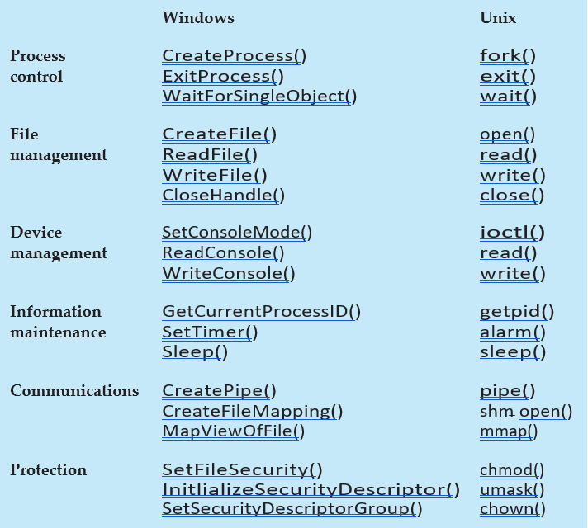

Slide 69
Popular types of OS
Desktop Class
Windows
OS X
Unix/Linux
Chrome OS
Server Class
Windows Server
Mac OS X Server
Unix/Linux
Mobile Class
Android
iOS
Windows Phone

Slide 70
Desktop Class Operating Systems:-
Platform: the hardware required to run a particular operating system
Intel platform (IBM-compatible)
Windows
DOS
UNIX
Linux
Macintosh platform
Mac OS
iPad and iPhone platform
iOS

Slide 71
Ms-DOS
Single User Single Tasking OS.
It had no built-in support for networking, and users had to manually install drivers any time they added a new hardware component to their PC.
DOS supports only 16-bit programs.
Command line user interface.
So, why is DOS still in use? Two reasons are its size and simplicity. It does not require much memory or storage space for the system, and it docs not require a powerful computer.

Slide 72

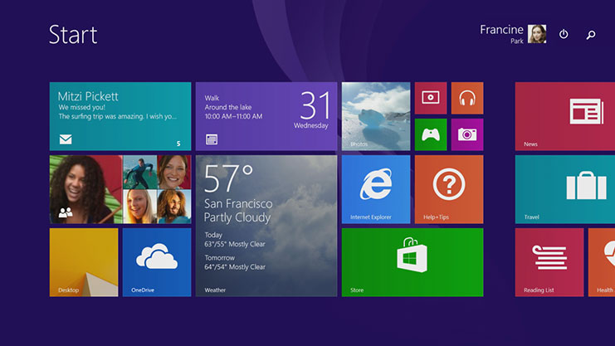
Microsoft Windows
The graphical Microsoft operating system designed for Intel-platform desktop and notebook computers.
Best known, greatest selection of applications available.
Current editions include Windows 7, 8, 8.1 and 10.

Slide 73
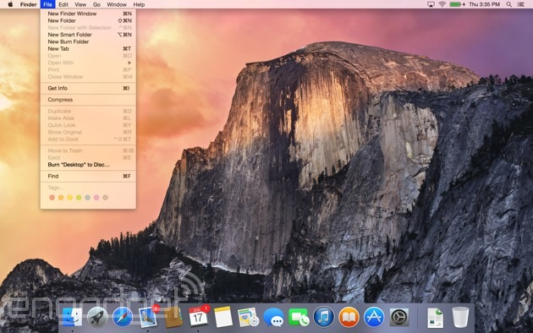
Mac OS
User-friendly, runs on Mac hardware. Many applications available.
Current editions include: Sierra, High Sierra, Mojave, Catalina & Big Sur—Version XI(Released in Nov 2020)

Slide 74

Linux
Linux: An open-source, cross-platform operating system that runs on desktops, notebooks, tablets, and smartphones.
The name Linux is a combination Linus (the first name of the first developer) and UNIX (another operating system.
Users are free to modify the code, improve it, and redistribute it,
Developers are not allowed to charge money for the Linux kernel itself (the main part of the operating system), but they can charge money for distributions (distros for short).

Slide 75
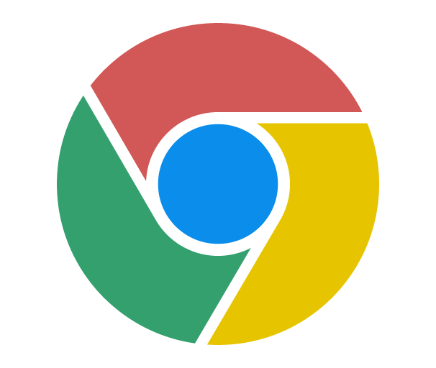
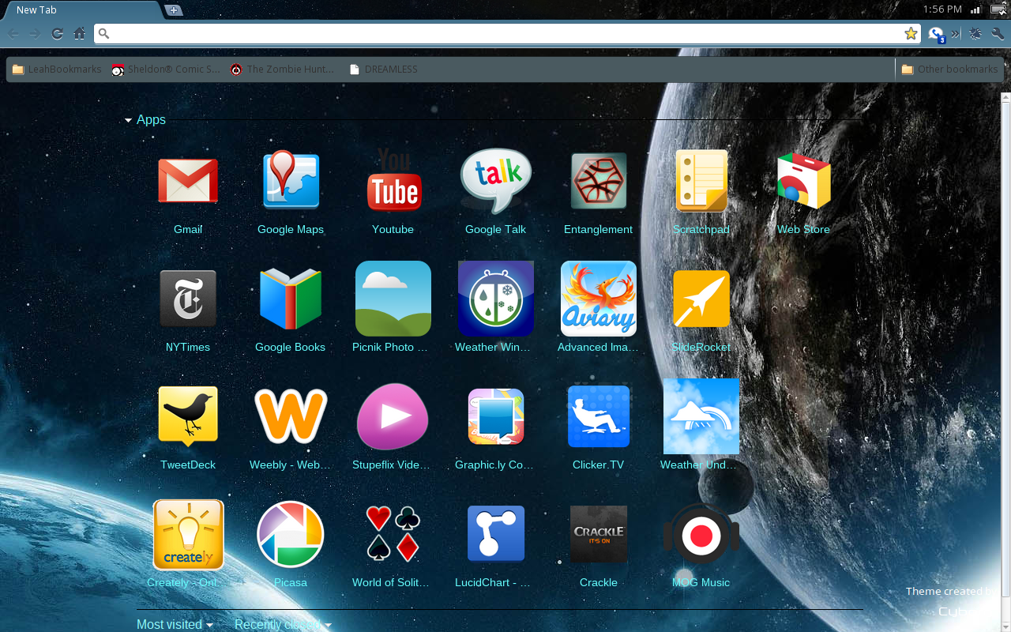
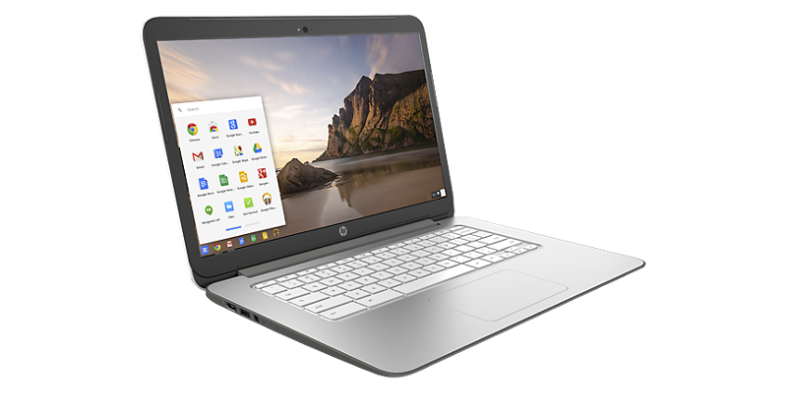

Google Chrome OS
Chrome OS. Is a popular thin client operating system.
Thin client A computer with minimal hardware, designed for a specific task. For example, a thin web client is designed for using the Internet.

Slide 76
Server Operating Systems
Windows Server
Familiar GUI interface for those experienced with Windows
UNIX
Very mature server capabilities, time-tested, large user community, stable
Linux
Free, customizable, many free services and utilities available

Slide 77
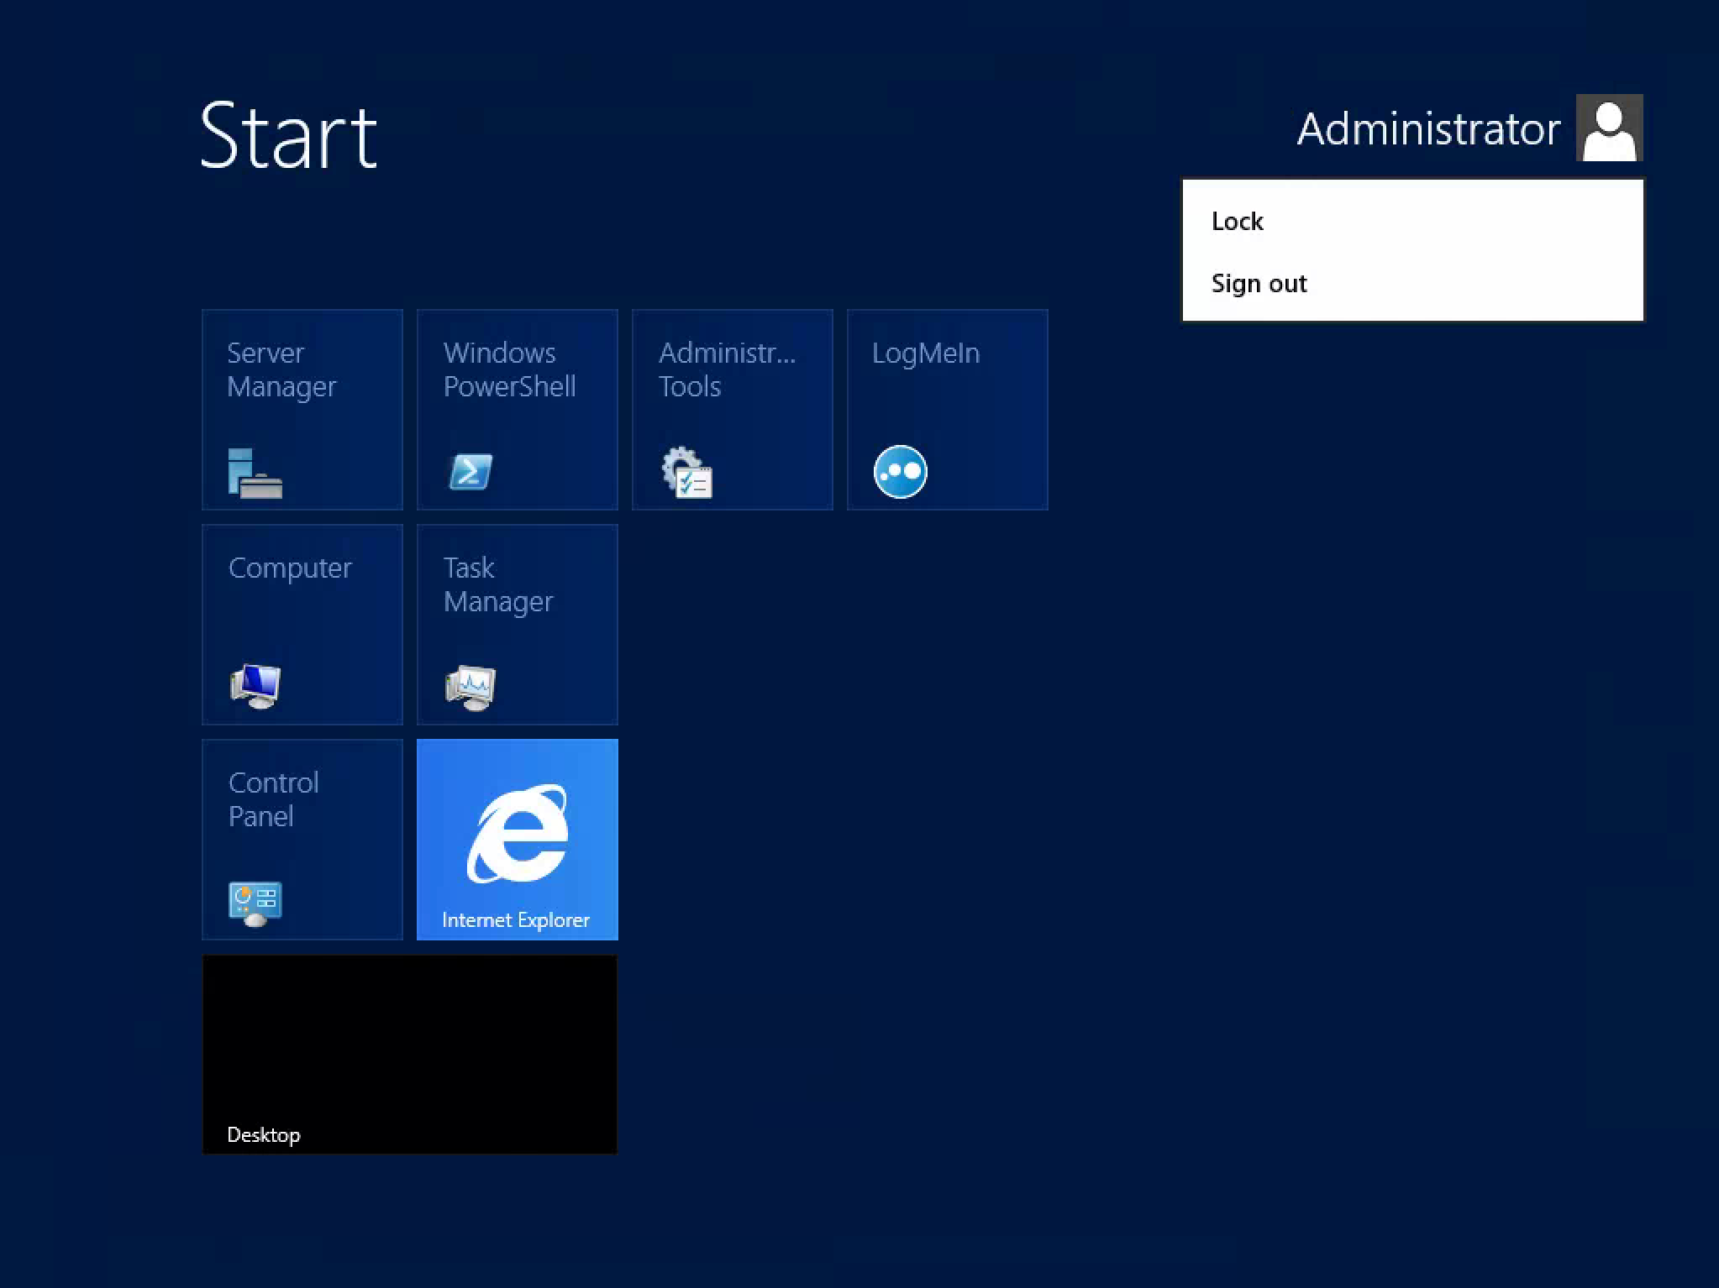
Windows Server

Slide 78
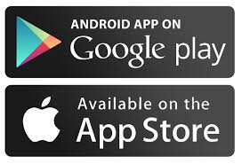
Tablet and Phone Operating Systems
System-on-chip (SoC): An operating system that comes preinstalled on a chip on a portable device such as a smartphone.
Popular SoC operating systems:
iOS: for iPad, iPhone
Android: for a variety of tablets and phones
Downloadable applications (apps) from an App store, for example:
Apple App Store
Google Play Store

Slide 79
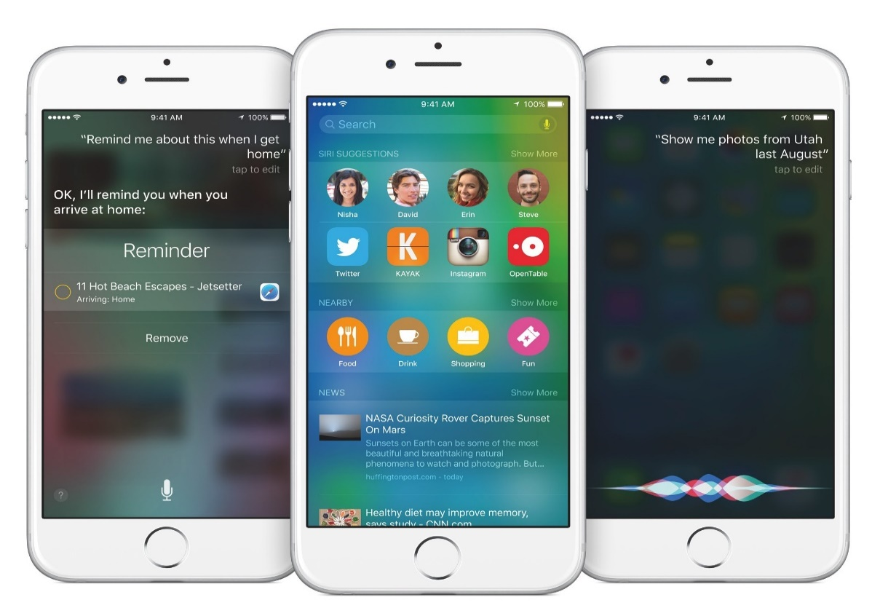
iOS on the iPhone and iPad
The Apple-created operating system for Apple tablets and phones.
The current stable version, iOS 14, was released to the public on September 16, 2020.

Slide 80

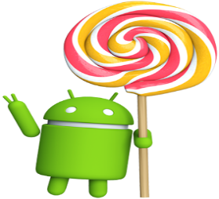
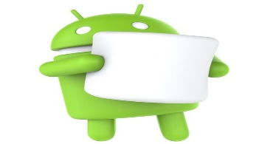
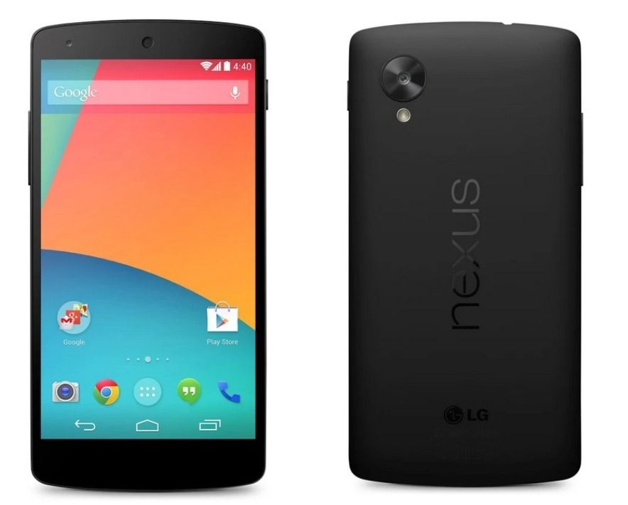
Android
Android, a popular OS for smartphones and tablets, is based on Linux Kernel.
Developed by Google
Current versions include:
Android 8 Oreo
Android 9 Pie
Android 10
Android 11 (released on Sep, 2020)

Slide 81
Advantage of Linux Operating System
1. Open Source 2. Security
3. Free 4. Lightweight
5. Stability 6. Performance
7. Flexibility 8. Software Updates
9. Distributions/ Distros 10. Live CD/USB
11. Graphical User Interface 12. Suitable for programmers
13. Community Support 14. Privacy
15. Networking 16. Compatibility
17. Installation 18. Multiple Desktop Support
19. Multitasking 20. Heavily Documented for beginners

